Slide 1

CSE 473
Pattern Recognition

Slide 2
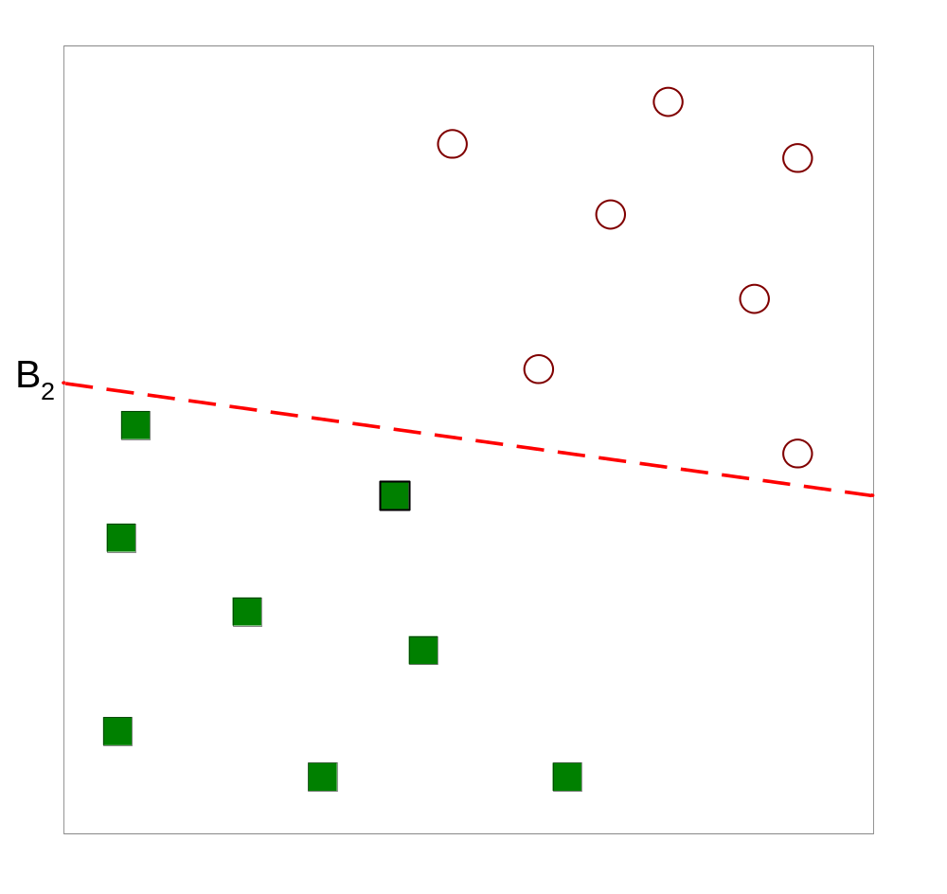
Linear Classifier: Introduction
Classifies linearly separable patterns
Assume proper forms for the discriminant functions
may not be optimal
very simple to use

Slide 3
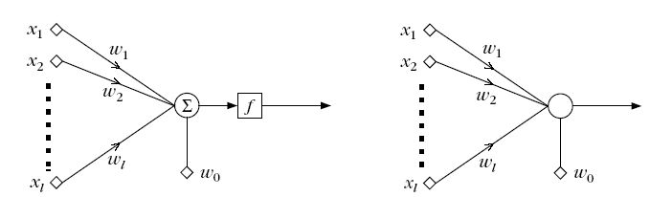
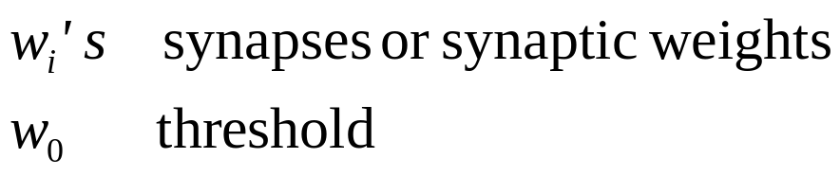
The Perceptron
This structure is called perceptron or neuron
a learning machine that learns from the training vectors

Slide 4
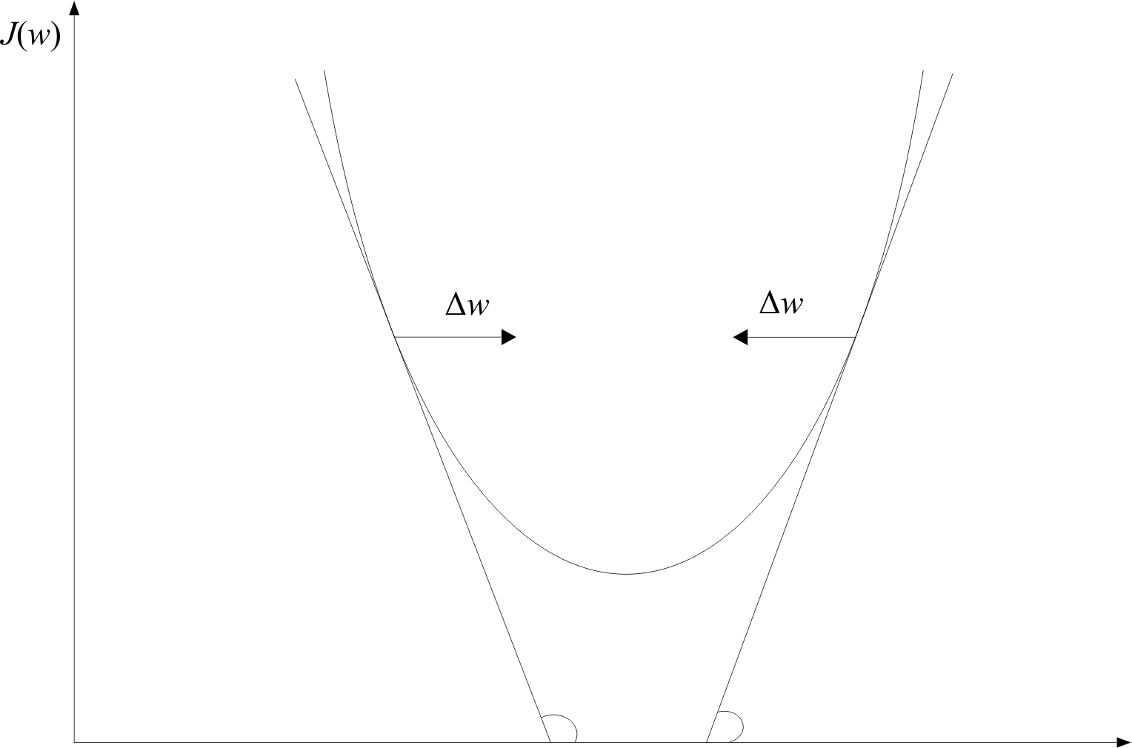
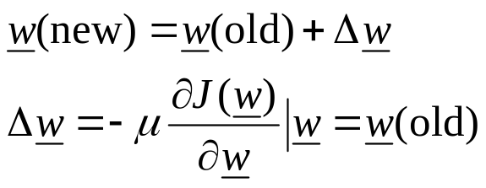
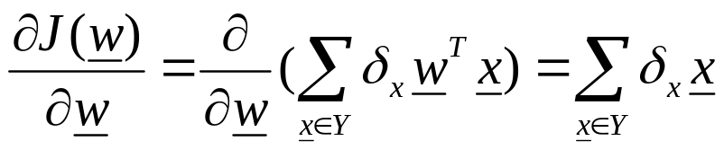
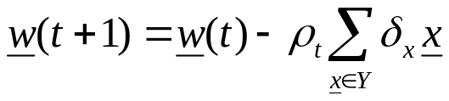
    Wherever valid
    This is the celebrated Perceptron Algorithm
w

Slide 5

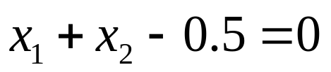
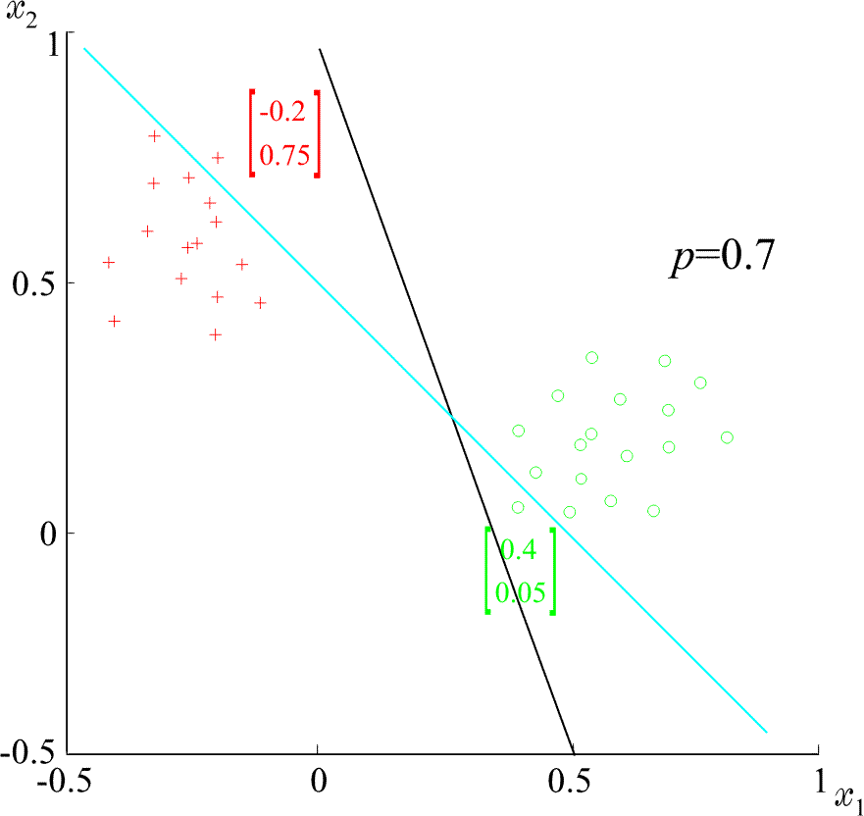
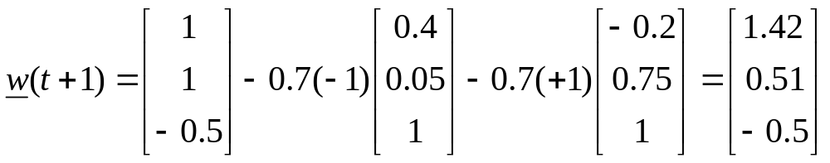
  Example: At some stage t the perceptron algorithm results in
  The corresponding hyperplane is
+
+
+
+
ρ=0.7
+
+
+

Slide 6
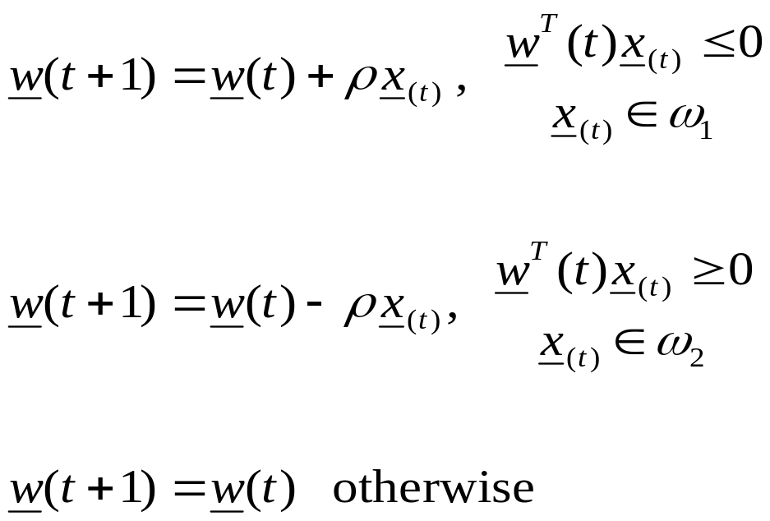
Variants of Perceptron Algorithm (1)

Slide 7

Variants of Perceptron Algorithm (1)
No Update

Slide 8
Variants of Perceptron Algorithm (1)
  It is a reward and punishment type of algorithm
No Update

Slide 9
Variants of Perceptron Algorithm (2)
initialize weight vector w(0)
define pocket w_{s}.and history h_{s}
generate next w(t+1). If it is better than w(t), store w(t+1) in w_{s} and change the h_{s}

Slide 10
Variants of Perceptron Algorithm (2)
initialize weight vector w(0)
define pocket w_{s}.and history h_{s}
generate next w(t+1). If it is better than w(t), store w(t+1) in w_{s} and change the h_{s}
  It is pocket algorithm

Slide 11
Generalization of Perceptron Algorithm for M- Class case

Slide 12
Generalization of Perceptron Algorithm for M- Class case
Let M classes ω_{1,} ω_{2,} ω_{3,} . . ., ω_{M,}
Let M linear discriminant functions, w_{i}

Slide 13

Generalization of Perceptron Algorithm for M- Class case
Let M classes ω_{1,} ω_{2,} ω_{3,} . . ., ω_{M,}
Let M linear discriminant functions, w_{i}
The object x is classified to ω_{i}, if

Slide 14
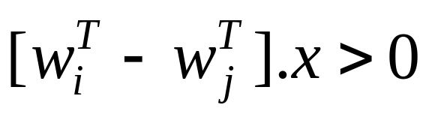
Generalization of Perceptron Algorithm for M- Class case
The object x is classified to ω_{i}, if

Slide 15
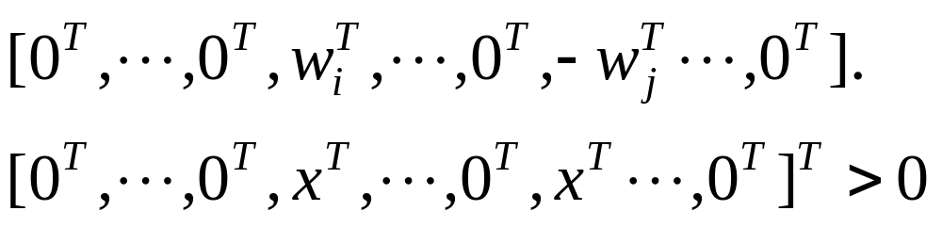
Generalization of Perceptron Algorithm for M- Class case
The object x is classified to ω_{i}, if
can be written as

Slide 16
Generalization of Perceptron Algorithm for M- Class case

Slide 17
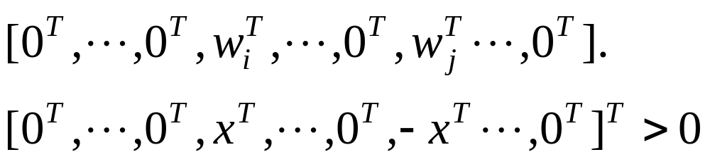
Generalization of Perceptron Algorithm for M- Class case

Slide 18
Generalization of Perceptron Algorithm for M- Class case

Slide 19
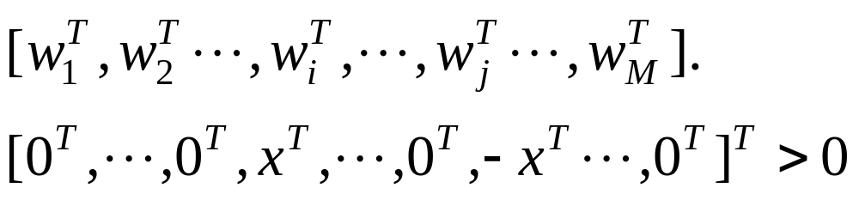
Generalization of Perceptron Algorithm for M- Class case

Slide 20
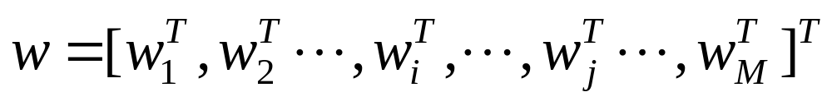
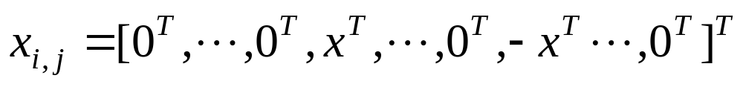
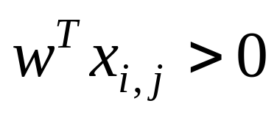
Generalization of Perceptron Algorithm for M- Class case
Let,
and
Then, the condition is

Slide 21
Generalization of Perceptron Algorithm for M- Class case
For each training vector of class ω_{i}, construct
ith location
jth location
(l+1)M dimension
Concatenate the weight vectors:

Slide 22
Generalization of Perceptron Algorithm for M- Class case
Use a single Perceptron to solve
Parameters:
  (l+1)M feature dimension
  All N(M-1) training vectors to be on positive side
This reorganization is known as Kesler’s construction

Slide 23
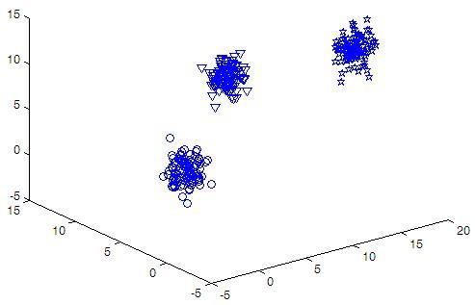
Sample Data for Sessional on
Perceptron Algorithms (Week 3 and 4)

Slide 24
Classes Features Samples
3 300
Feature1 Feature2 Feature3 Class
11.0306 9.0152 8.0199 1
11.4008 8.7768 6.7652 1
11.2489 9.5744 8.0812 1
9.3157 7.4360 5.6128 1
15.7777 1.5879 11.4440 2
15.8685 2.7902 11.2532 2
14.9448 0.7798 12.7481 2
15.9801 1.0142 14.2029 2
2.3979 5.6525 2.7566 3
2.5103 6.3484 1.4272 3
2.7527 4.6571 3.1138 3
-0.0195 4.5524 0.0118 3
Sample Data
for
Perceptron

Slide 25
What to do?
No. of features and classes will be variable
Use training file to train (1) basic, (2) reward and punishment, (3) pocket and (4) kesler’s reconsturction
Use test file to evaluate the performance and identify the misclassified samples
Any programming language cannot be used
Upload your program to moodle by 10 pm on next Sunday
Use different data files during evaluation

Slide 26
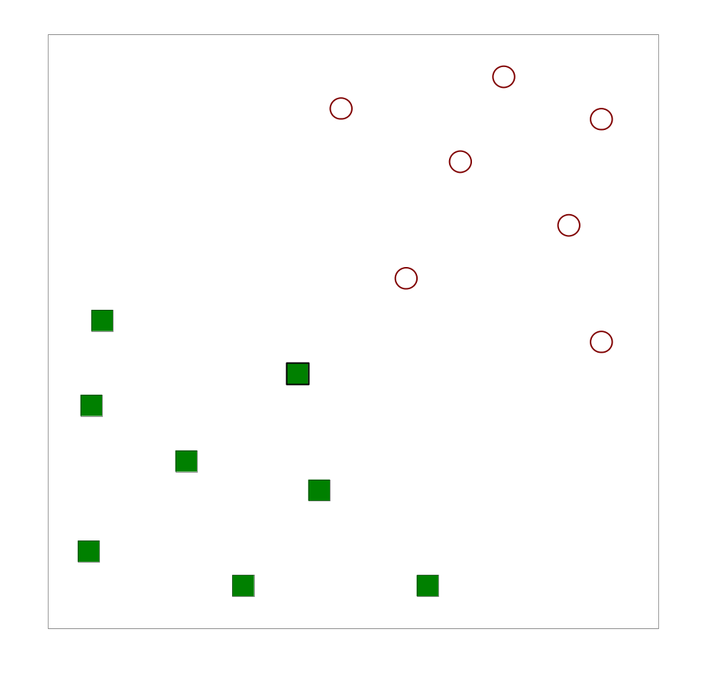
Two-Class case again
Let, we have N training samples

Slide 27
Two-Class case again
Let, we have N training samples
Find a linear hyperplane (decision boundary) that will separate the data

Slide 28
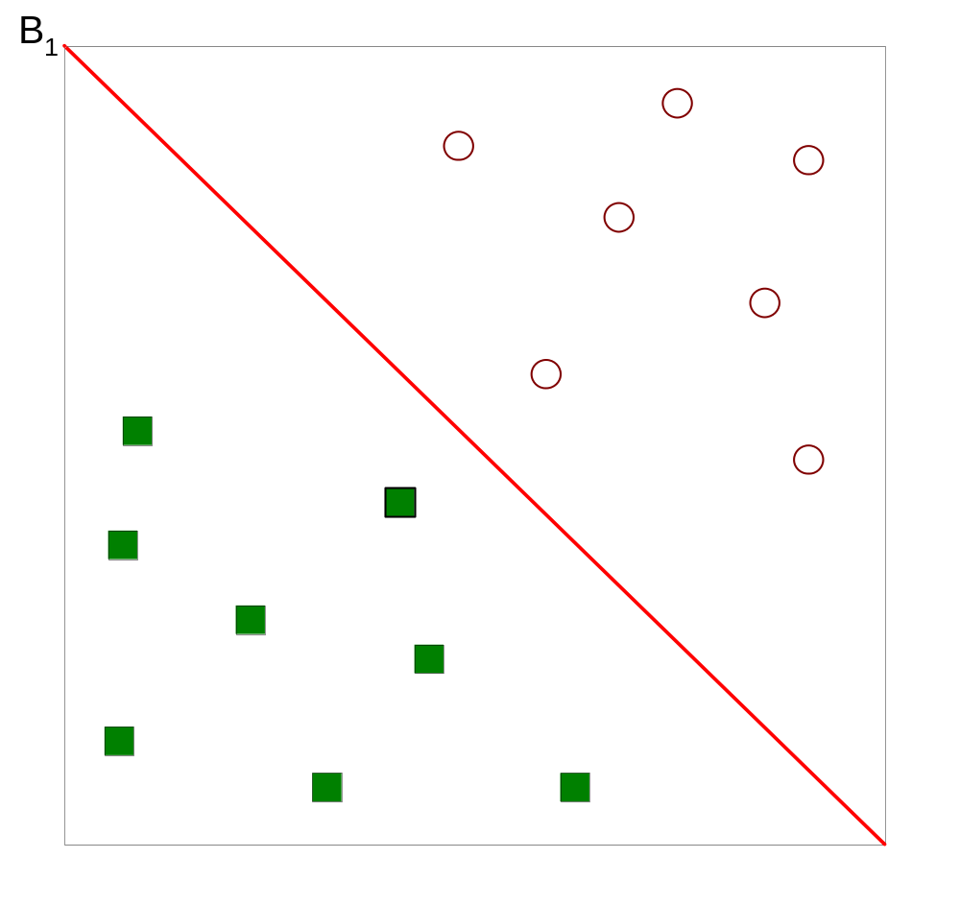
Two-Class case again
B₁
One Possible Solution

Slide 29
Two-Class case again
B₂
Another possible solution

Slide 30
Two-Class case again
B₂
Other possible solutions

Slide 31
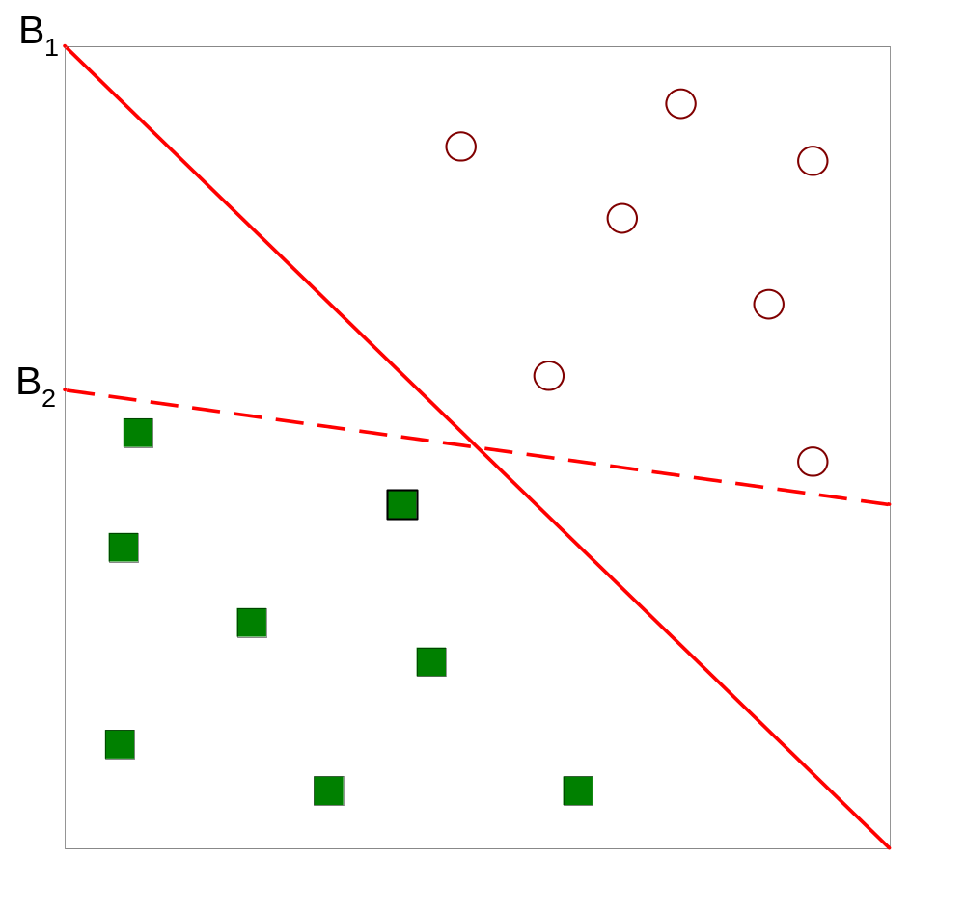
Two-Class case again
B₁
B₂
Which one is better? B₁ or B₂?
How do you define better?

Slide 32
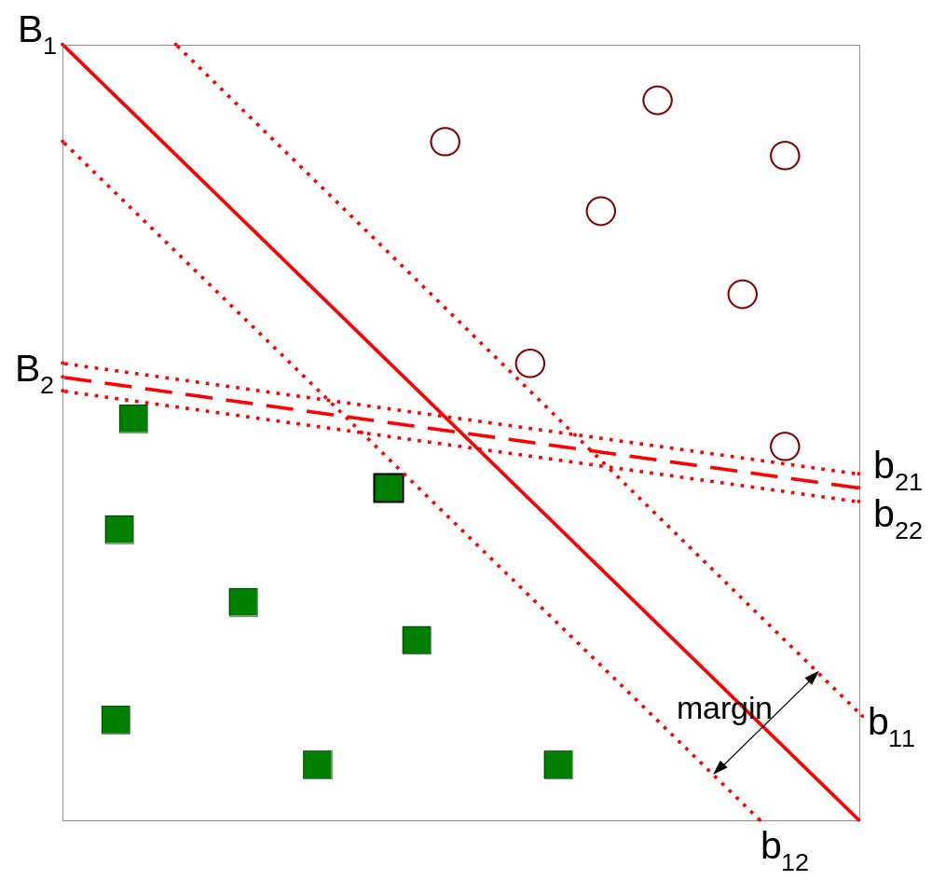
Two-Class case again
B₁
B₂
b₂₁
b₂₂
b₁₁
b₁₂
Find hyperplane maximizes the margin => B1 is better than B2

Slide 33
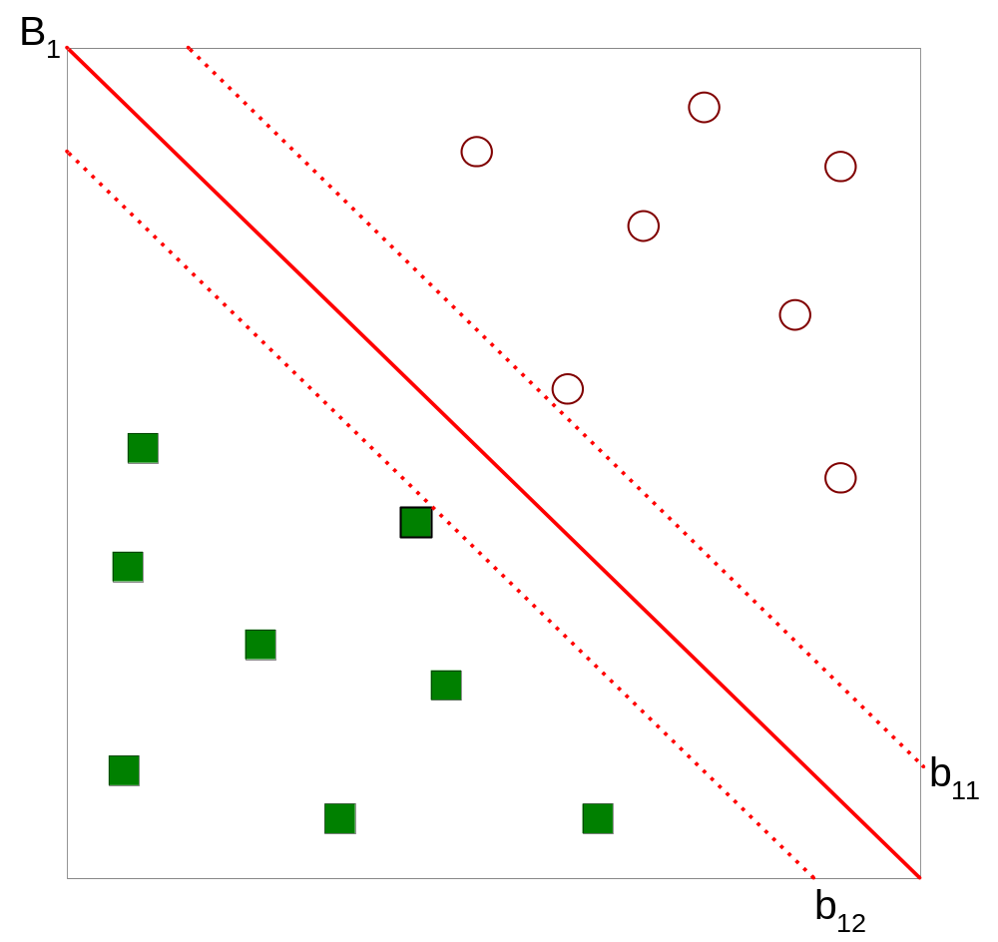

Two-Class case again
B₁

Slide 34


Two-Class case again
B₁
b₁₁
b₁₂

Slide 35
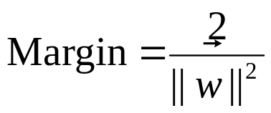
Two-Class case again
B₁
b₁₁
b₁₂

Slide 36
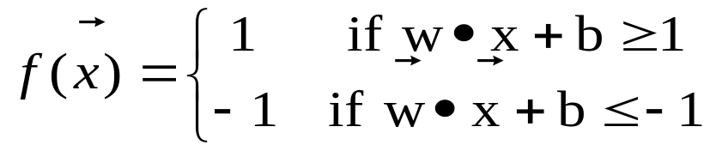
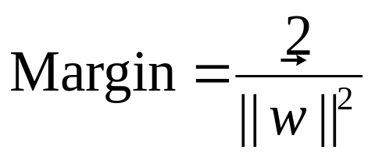
Two-Class case again
B₁
b₁₁
b₁₂

Slide 37
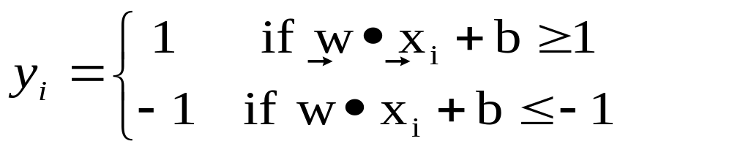
Support Vector Machine
We want to maximize:
  subject to the following constraints:

Slide 38
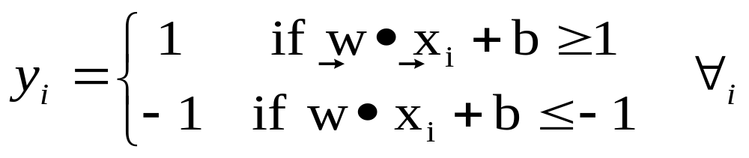
Support Vector Machine
We want to maximize:
  subject to the following constraints:

Slide 39
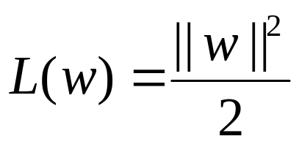
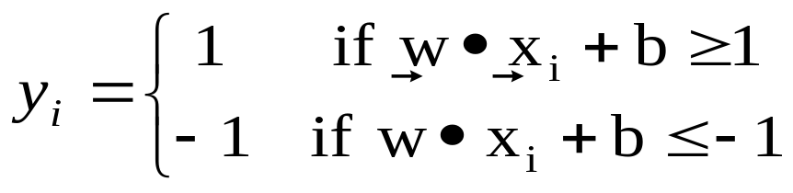
Support Vector Machine
We want to maximize:
  Which is equivalent to minimizing:
  subject to the following constraints:

Slide 40
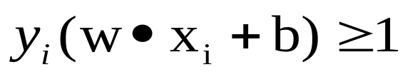
Support Vector Machine
The Expression
can be written as

Slide 41
Support Vector Machine
The Expression
can be written as
We can say :
  minimize:
  Subject to:

Slide 42
Support Vector Machine
is a quadratic equation
Solving for w and b is not easy

Slide 43
Support Vector Machine
is a quadratic equation
Solving for w and b is not easy
What happens if w =0?

Slide 44
Support Vector Machine
is a quadratic equation
Solving for w and b is not easy
What happens if w =0?
Some of
may be infeasible

Slide 45
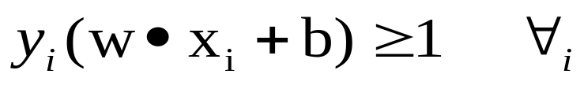
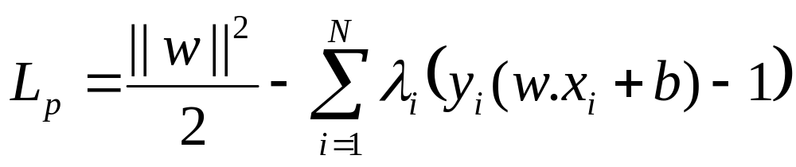
Support Vector Machines
  minimize:
  Subject to:
Use Lagrange function:

Slide 46
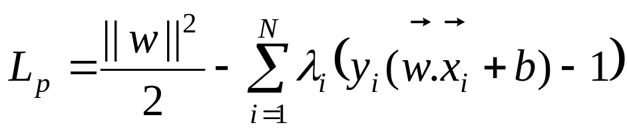
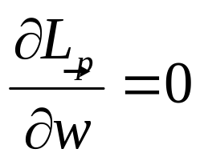
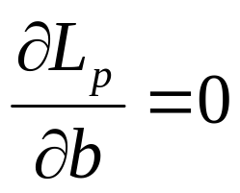
Support Vector Machines
Lagrange function:
New constraints are:

Slide 47
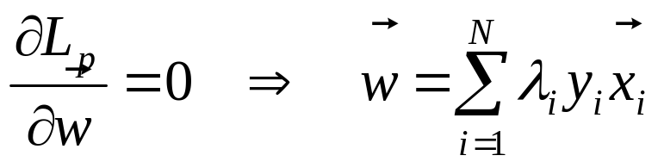
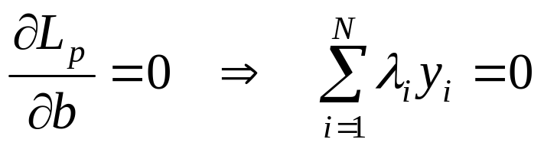
Support Vector Machines
Lagrange function:
New constraints are:

Slide 48
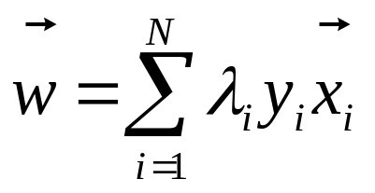
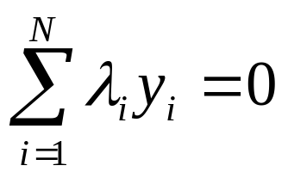
Support Vector Machines
Lagrange function:
constraints are:
Still not solvable, many variables

Slide 49
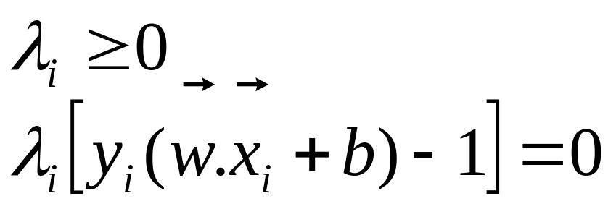
Support Vector Machines
Use Lagrange function:
constraints are:
From Karush-Kuhn_Tucker Transform,

Slide 50
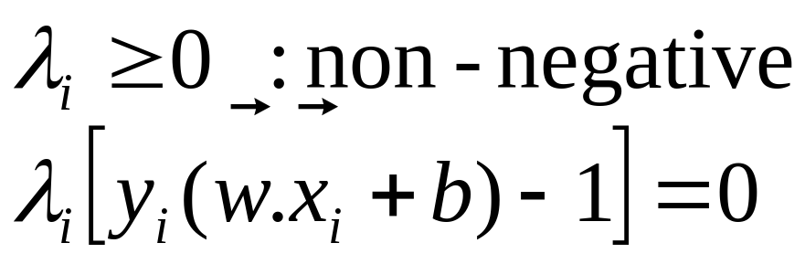
Support Vector Machines

Slide 51
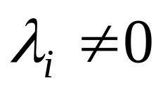
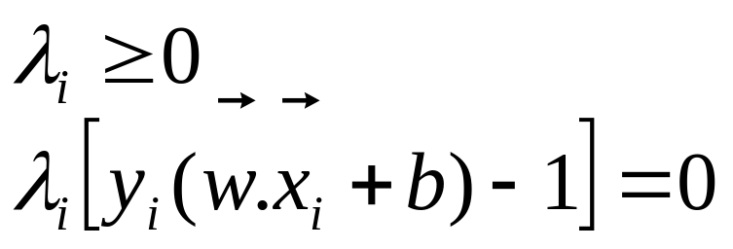
Support Vector Machines
B₁
Support Vectors

Slide 52
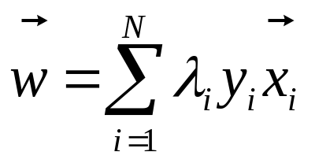
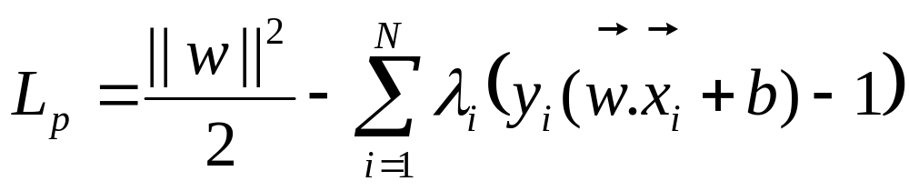
Support Vector Machines
Replace w with λ’s in L_{p} :
put
and
in

Slide 53
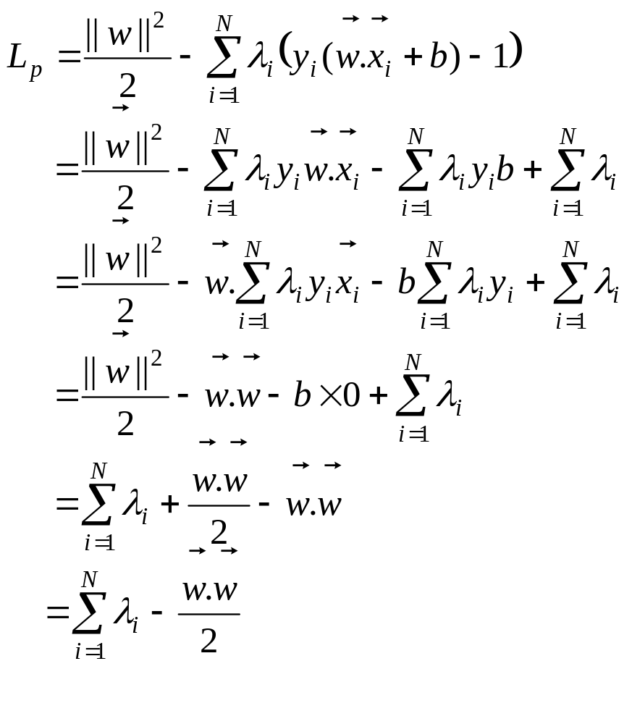

Slide 59
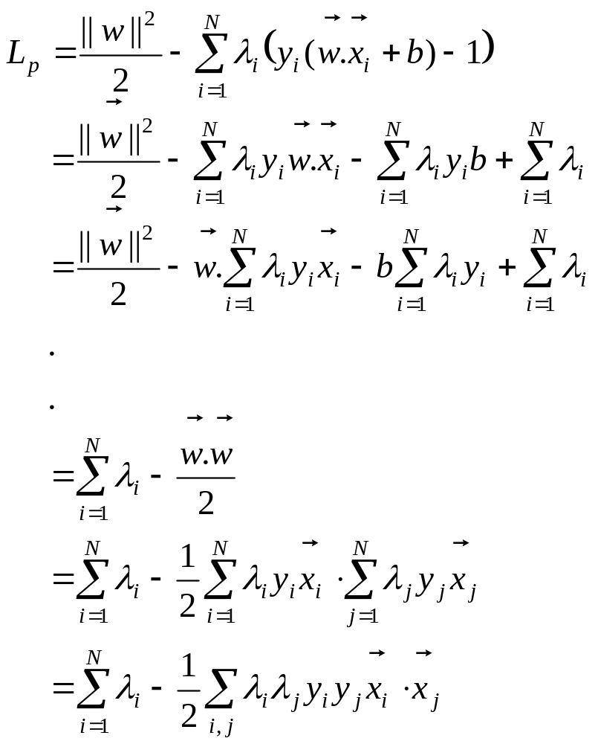

Slide 61
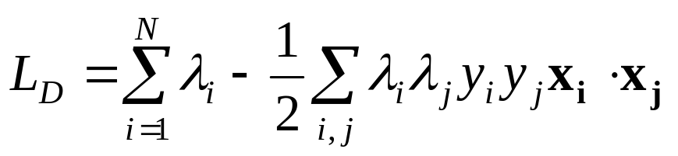
Support Vector Machines
Replace w with λ’s in L_{p} :
The dual to be maximized:

Slide 62


Support Vector Machines
After solving λ’s :
  Find w and b:

Slide 63

Support Vector Machines
Classify an unknown example z:

